Slide 1
Software Reusability
Main issues:
• Why is reuse so difficult
• How to realize reuse
©2008 John Wiley & Sons Ltd.
www.wileyeurope.com/college/van vliet
Notes:
© SE;Reusability, Hans van Vliet

Slide 2
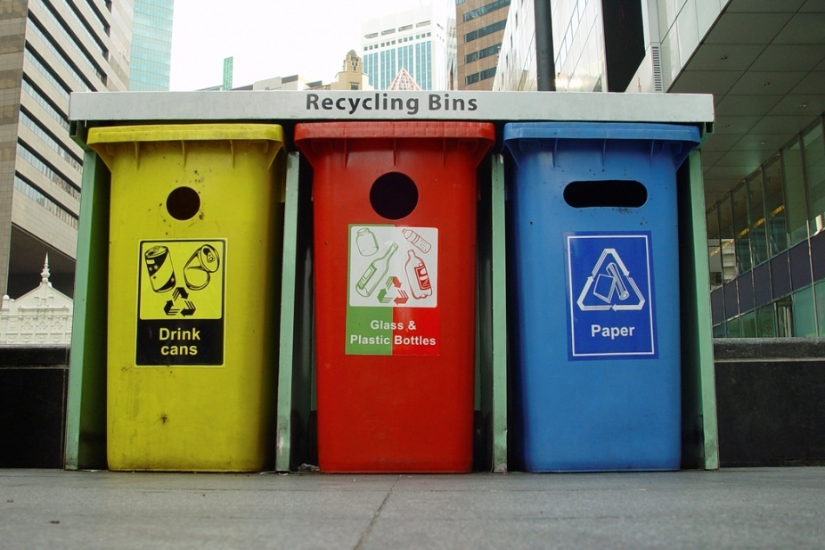
Reuse dimensions
Things being reused: components, concepts, …
Scope: horizontal vs vertical
Approach: systematic or opportunistic
Technique: compositional or generative
Use: black-box or white-box
Product being reused: source code, design, …
©2008 John Wiley & Sons Ltd.
www.wileyeurope.com/college/van vliet

Slide 3
Success criteria for component libraries
Well-developed field, standard terminology
Small interfaces
Standardized data formats
©2008 John Wiley & Sons Ltd.
www.wileyeurope.com/college/van vliet

Slide 4

Requirements for component libraries
Searching for components
Understanding/evaluating components found
Adapt components if necessary
Compose systems from components
©2008 John Wiley & Sons Ltd.
www.wileyeurope.com/college/van vliet

Slide 5
Component evaluation, useful information
Quality information
Administrative information (name developer, modification history, etc)
Documentation
Interface information
Test information
©2008 John Wiley & Sons Ltd.
www.wileyeurope.com/college/van vliet

Slide 6
Reuse process models
Software development with reuse
  Passive
  Component library evolves haphazardly
Software development for reuse
  Active
  Reusable assets are developed, rather than found by accident
©2008 John Wiley & Sons Ltd.
www.wileyeurope.com/college/van vliet

Slide 7
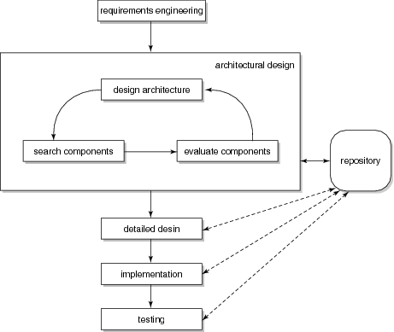
Software development with reuse
©2008 John Wiley & Sons Ltd.
www.wileyeurope.com/college/van vliet

Slide 8
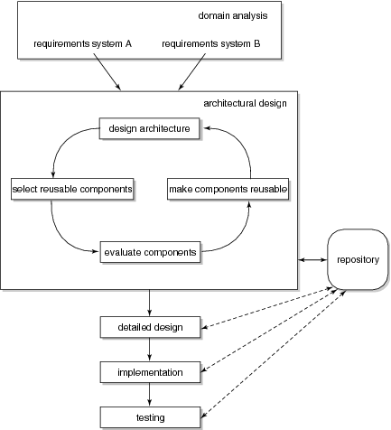
Software development for reuse
©2008 John Wiley & Sons Ltd.
www.wileyeurope.com/college/van vliet

Slide 9
Software development for reuse
Often two separate development processes:
  Development of components (involving domain analysis)
  Development of applications, using the available components
Specific forms hereof:
  Component-based software development
  Software factory
  Software product lines
©2008 John Wiley & Sons Ltd.
www.wileyeurope.com/college/van vliet

Slide 10

Reuse tools and techniques
Languages to describe compositions
  Module Interconnection Language (MIL)
  Architecture Description Language (ADL)
Middleware (CORBA, JavaBeans, .NET)
©2008 John Wiley & Sons Ltd.
www.wileyeurope.com/college/van vliet

Slide 11
Characteristics of successful reuse programs
Extensive management support
Organizational support structure
Incremental implementation
Significant success
High incentives
Domain analysis done
Attention to architectural issues
©2008 John Wiley & Sons Ltd.
www.wileyeurope.com/college/van vliet

Slide 12
Non-technical aspects of software reuse
Economics: it is a long term investment
Management: it does not happen spontaneously
Psychology: people do not want to reuse someone else’s code
©2008 John Wiley & Sons Ltd.
www.wileyeurope.com/college/van vliet

Slide 13
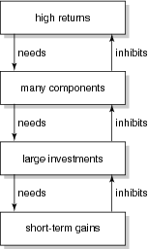
Reuse devil’s loop
©2008 John Wiley & Sons Ltd.
www.wileyeurope.com/college/van vliet

Slide 14
Summary
We can reuse different things: code, design, …
Reuse can be systematic (software development for reuse), or opportunistic (software development with reuse)
Reuse does not just happen; it needs to be planned
©2008 John Wiley & Sons Ltd.
www.wileyeurope.com/college/van vliet

